Slide 1


Integration of Artificial Intelligence in
Data collection in
Statistics South Africa
Presenter: Sibusiso Langatshe

Slide 2
Presentation Outline
Introduction
Objectives
Benefits of AI Technology
Future
Conclusion

Slide 3
Introduction
Stats SA has been introducing technology by improving data collection process
By aligning its operational model with international best practices
This is by introducing innovations such as AI-powered case management, real-time monitoring tools, and GIS-integrated sampling
Stats SA is taking critical steps toward a more integrated, efficient, and scalable survey system.
By introducing Integrated Operational Model (IOM) into field operations and data collection
The IOM is not merely a technical reform—it is a strategic enabler of Stats SA’s long-term vision for data modernization, institutional resilience, and evidence-based policy support.

Slide 4
Objectives
Expand Geographic Coverage: Offering detailed data collection at the district and local municipal levels.
Optimize Data Collection Techniques: Utilizing advanced technologies like AI-powered case management systems to enhance operational efficiency​.
Enhance the Master Sample: Using data from Census 2022 to create a more accurate, geo-referenced master sample that improves sampling precision​.
Integration ensures a seamless, technology-driven data collection model that supports South Africa’s goal of producing high-quality, timely, and locally relevant statistics

Slide 5
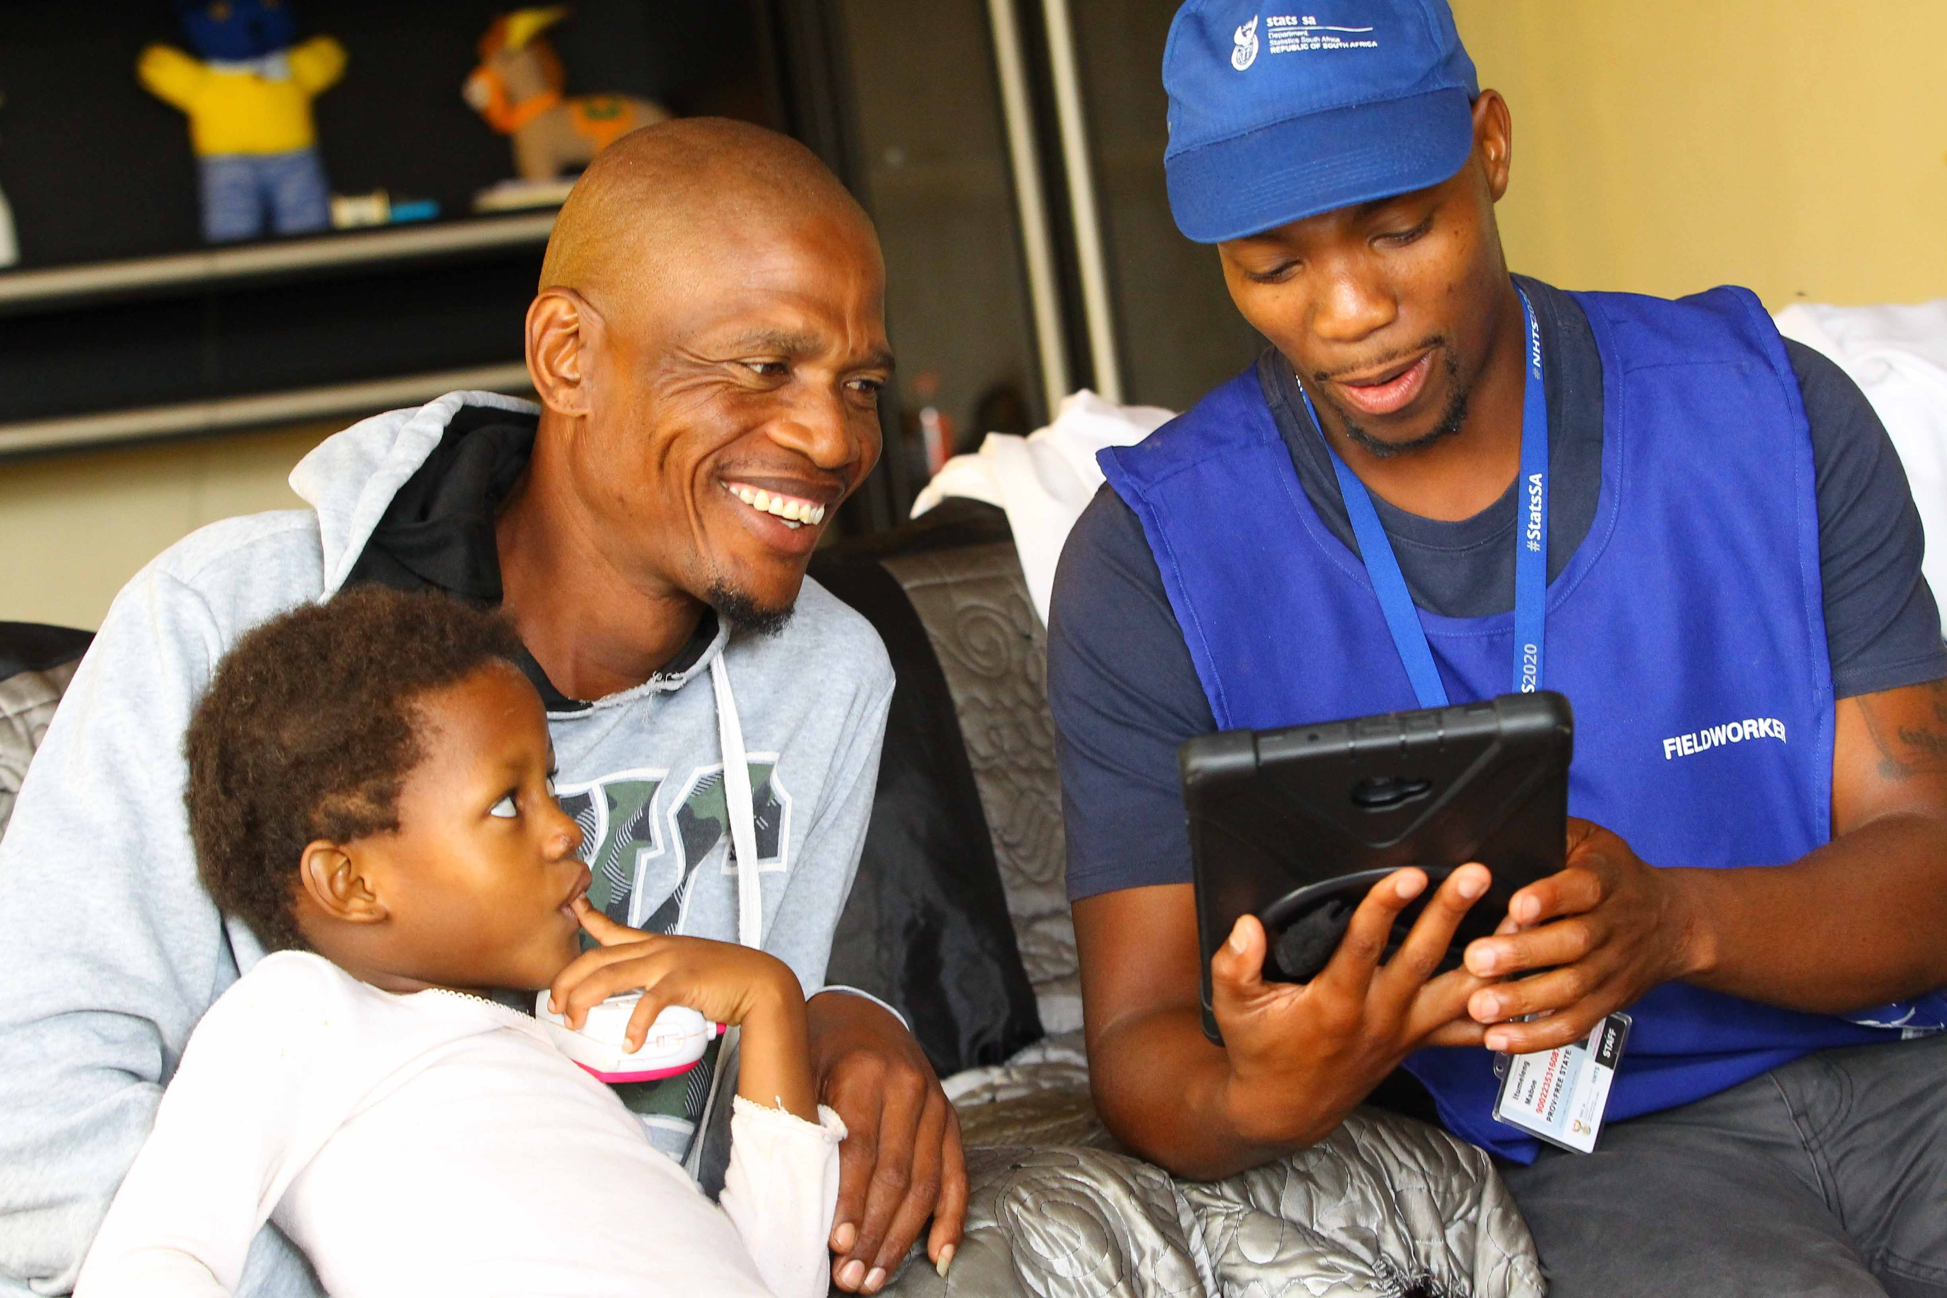
Benefits of Introducing AI Technology
Improved Efficiency through Multi-Survey Fieldworker Deployment
    The single-surveyor model allows Stats SA to consolidate field resources, reducing the number of personnel required per PSU.
    This reduces duplication of effort, minimizes scheduling conflicts, and improves continuity in data collection.
    It also enables better workload distribution when integrated with GIS-based routing systems.

Slide 6
Benefits of Introducing AI Technology
Marginal Reduction in Training Costs
  The IOM model introduces some training efficiencies by replacing the need for separate sessions across survey teams with integrated training programmes.
  A single SO is trained once to administer multiple instruments, reducing duplicated instructional hours, travel costs for training, and accommodation needs.
  This results in a modest reduction in training expenditure; however, the need for specialized content, practical simulation modules, and refresher training for complex multi-survey handling offsets some of these gains

Slide 7
Benefits of Introducing AI Technology
Enhanced Data Accuracy through Computer Assisted Personal Interview (CAPI)
  The use of CAPI reduces manual errors, improves real-time validation, and facilitates faster data transmission.
  This directly improves data reliability and timeliness—especially important in longitudinal or repeated surveys under the CPS framework.

Slide 8
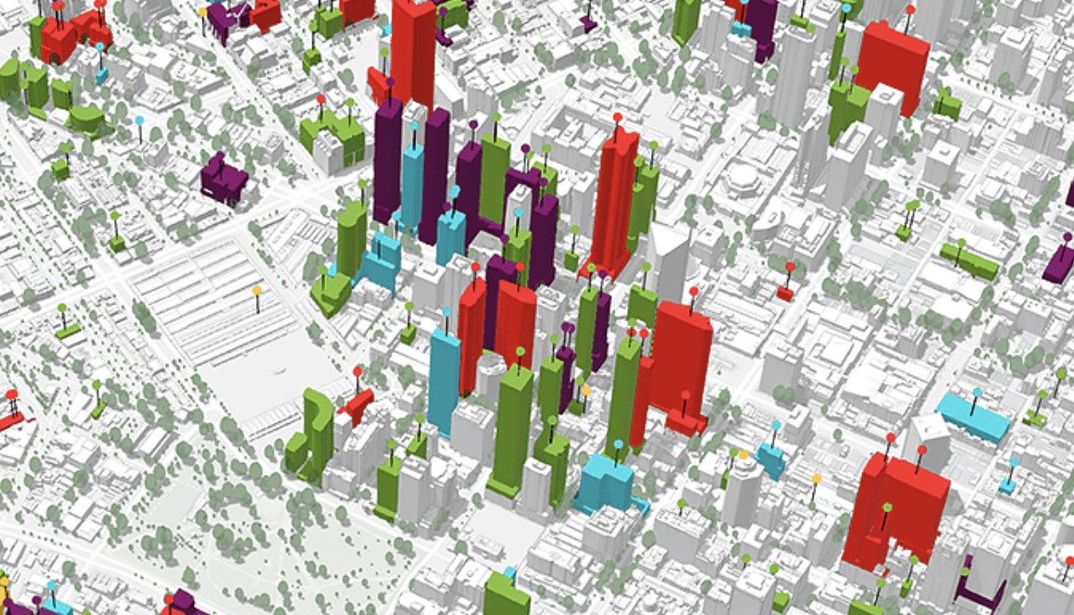
Benefits of Introducing AI Technology
Navigation and Sampling Efficiency through GIS Tools
GIS-based sampling supports more accurate PSU targeting, reduces duplication, and facilitates better spatial workload balancing.
However, challenges persist in rural areas where GPS accuracy is low and travel distances between sampled households remain substantial

Slide 9
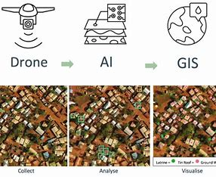
Going Forward (Future)
Work together with private sector
Adopt international standards used in other countries and in South Africa (SDI Act 2003 no. 54)
Also look at cost effective technology that can reduce human error
Test the use of drones in data collection especially in Informal settlement and areas that are hard to reach
Remote sensing technology

Slide 10
Conclusion
The IOM directly supports Stats SA’s Strategic Vision for Data Collection by:
    Modernizing household surveys through AI-driven data collection and real-time monitoring tools​.
    Enhancing data quality and reducing response times by leveraging integrated case management systems
    Minimizing operational costs through the elimination of redundant field visits and digitalizing survey methods
    Increasing flexibility and adaptability in survey operations to respond effectively to evolving data needs.

Slide 11
Contact
For any queries and challenges, contact the following Stats SA Officials:
Sibusiso Langatshe
SibusisoL@statssa.gov.za
082 676 9609
Sibusiso Nyuswa
SibusisoNy@statssa.gov.za
066 802 1552

Slide 12
Thank you

