Slide 1
CD:NGI MAP DESIGN PROJECT AWARENESS
1:10 000 Ortho Photo Map
1: 50 000 Topographic Map

Slide 2
PROPOSED CHANGES ON NATIONAL MAP SERIES
The Chief Directorate: National Geospatial Information (CD: NGI)’s main objective is to produce national maps series and other geospatial information.
Prepare, compile and amend such maps and other cartographic representations of geo-spatial information as may be required;
CD: NGI has embarked on the Map Design project aimed at enhancing and improving the mapping products, where symbologies have been re-designed using good map principles and user communication value.
To improve services and to keep up with trends and ensure universality.

Slide 3
The official SA Languages to be used
The national languages used in the maps will be reviewed in the context of the official languages of South Africa.
the language policy of the Department of Agriculture, Land Reform & Rural Development (DALRRD) (including language for administration in the public service)
The constitutional mandate requires all official languages to be used in the country.
The four proposed languages to be used on two scales 1: 10 000 and 1:50 000 are English, Afrikaans, one Nguni languages and one Sotho languages.

Slide 4
Proposed symbols
Changed annotation of:
Post Office - “Po”
Police Station - “Ps”
Store - “St”
Place of Worship - “Pw”
School - “Sc”

Slide 5
Alpha-numeric grids
1:10 000 – 30 seconds Interval
A standard map in this map series covers an area of 3 minutes by 3 minutes
Proposed alphanumeric reference divided up into a 30-seconds by 30-seconds grid, providing 36 reference blocks for easy referencing.
1:50 000 – 1 minute interval
A standard map in this map series covers an area of 15 minutes by 15 minutes.
Proposed alphanumeric reference divided up into a 1-minute by 1-minute grid, providing 225 reference blocks for easy referencing.

Slide 6
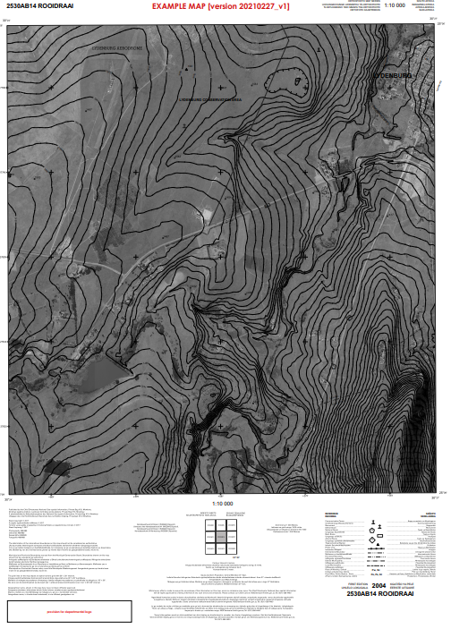
Planned Key changes 1:10 000 scale Orthophoto Map series

Slide 7
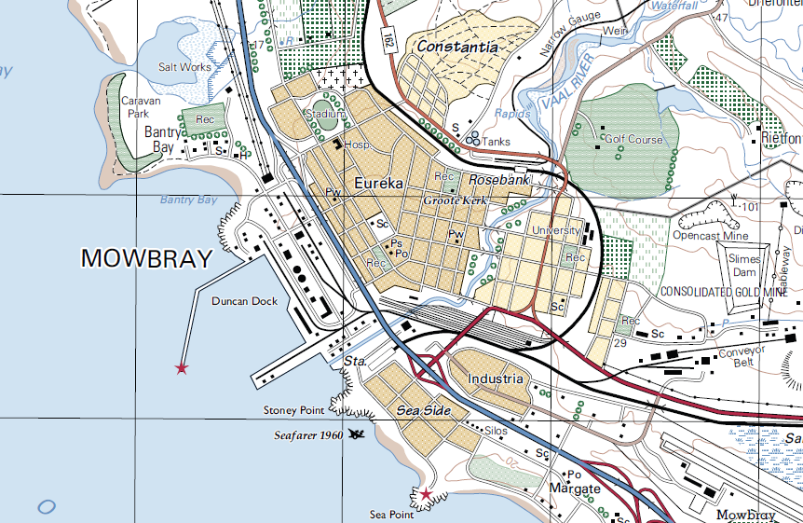
Planned Key changes – 1:50 000 scale topographic map series

Slide 8
QUESTIONNARE’S LINK
https://forms.office.com/Pages/ResponsePage.aspx?id=NSp5H6cCPk6eev9ArjkMtpsgYekMuF1LvwkbNR4hZWtUNkhOUVhQNTY0WU41NTY3RjNEVEY0TlU0Uy4u

Slide 9
Thank you
Baie dankie
Ngiyabonga
Ke a leboga

