Slide 1

The Geo-Information Society of South Africa
Professional registration with the SAGC & SACNASP: The role of GISSA
Daniel Jooste
GISSA Gauteng Committee
08/11/2023
Notes:
As students you are contained in a very diverse bubble. You are exposed to multiple topics in the Geo-information space and you have the opportunity to get new research first hand from academic institutions. If you are lucky you also have lecturers that bring in external speakers to further enrich your experience of your chose field.
Once you leave this bubble and start working, you will experience a rapid shift in this exposure.
Each company and organization has its own focus area and bottom line, which can lead to a pigeonholing effect on your views of the geo-information industry.
In order to stay up to date and connected to the larger field, each practitioner needs to take things into their own hands. This means doing your own research, attending conferences or furthering your studies.
This is where GISSA plays a critical role.

Slide 2
  The Geo-Information Society of South Africa (GISSA) is a voluntary association that works in a synergistic relationship with the South African Geomatics Council (SAGC) to promote the Geomatics profession in our country.
  The SAGC is the overarching body that governs multiple facets of practicing professionals as enshrined in Legislation.
What is GISSA?
  Geomatics Professional Act No. 19 of 2013
  To provide for the transformation of the geomatics profession; to provide for the establishment of the South African Geomatics Council (SAGC) as a juristic person; to provide for the facilitation of accessibility to the geomatics profession; to provide for different categories of registered persons and branches in the geomatics profession; to provide for the identification of areas of work to be performed by the different categories of registered persons; to provide for the recognition of certain voluntary associations by the Council; to provide for measures designed to protect the public from unethical geomatics practices; to provide for the establishment of disciplinary mechanisms; to provide for the establishment of an Appeal Board; and to provide for matters connected therewith.
Notes:
In South Africas legislation there is an act that governs the actions of geomatics professionals. This is a valuable piece of legislation for our industry as it adds weight to the importance of our field and also protects the public from bad practice.
This is the space where the SAGC operates and I wont go into to much detail there.
But in chapter 4 of this act there are guidelines for voluntary association of institutes, organizations, and other bodies who want to protect the interests of our profession.
GISSA is one of these voluntary associations founded under the principles of the Geomatics Professionals Act. As such we have diverging and overlapping actions but always with a singular goal.

Slide 3
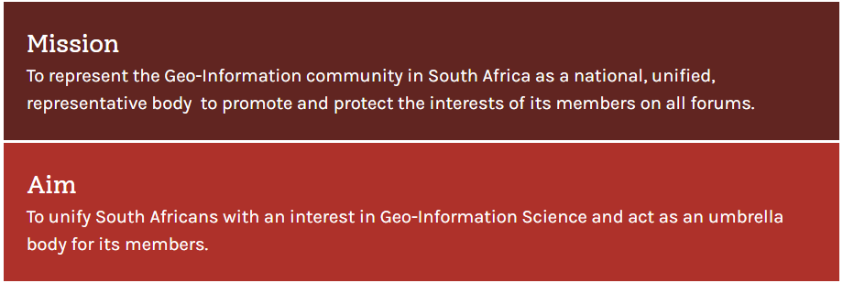
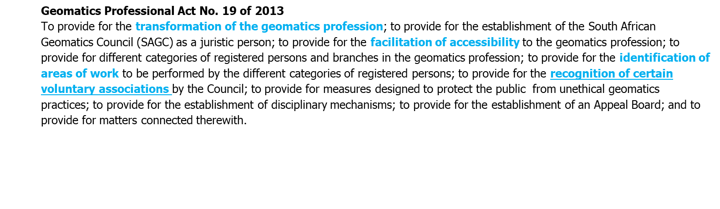
What is GISSA?
Notes:
So GISSA’s Aim and Mission stem from Geomatics professionals act.
Our mission is to represent the geo-information community in south Africa, as a national, unified representative body.
Out Aim is to unify South Africans with an interest in geo-information science.
Therefore we are not an organisation with prerequisites such as professional registration, we facilitate the engagement of the broader industry and related fields among each other.
We have a singular national committee and sub-committees in each province. All committee members are voluntary and perform action the mission for the benefit of the wider community.

Slide 4







Skills development and training
GISSA Focus areas
Institutions and higher learning
Research and Development
Industry engagement and
opportunities
Notes:
GISSA has multiple focus areas, often differing between provinces to some degree. This is guided by the national council as well as input from the members.
The organization is a centre point for these focus areas and many others to aid the community.

Slide 5
Skills development and training
GISSA Focus areas
Organization of frequent Regional meetings & national AGM with Continued Professional Development (CPD) points.
  Members and Organisations have the opportunity to share their knowledge and activity in the Geospatial industry.
  Attendees stay abreast of innovation, technology, profession, and other industry developments.
  CPD points contribute to maintaining professional registration with organizations such as SAGC.
Conference organization and hosting with CPD points
  Continuous support of local & international conferences, summits, and workshops.
  Promotion of youth and academic attendance at conferences.
Notes:
We organise regular regional meetings, summits, workshops and we assist and promote conferences and events.
We also strive to include youth in all of these activities to fulfil the Geomatics act mandate of transforming the industry and broadening accessibility.
Registered professionals of organizations like the SAGC earn continued professional development points, required to maintain their registration.

Slide 6
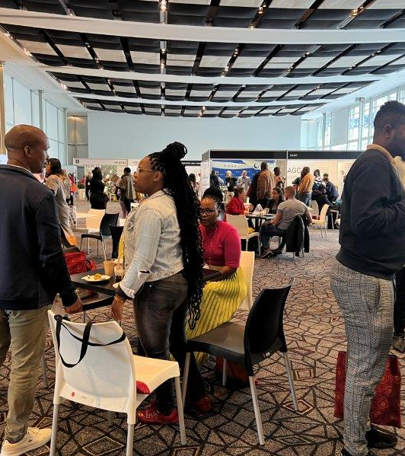
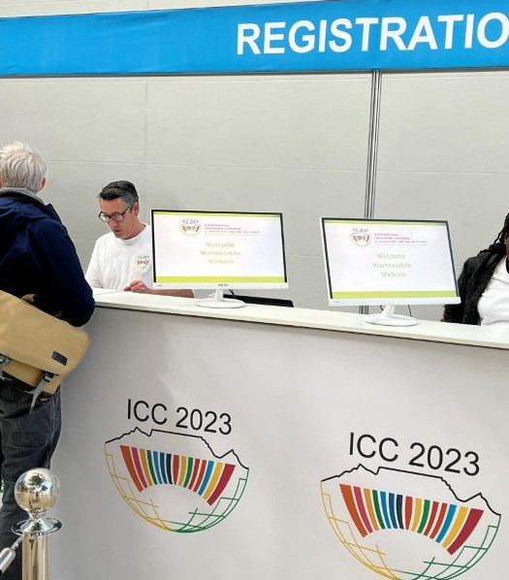
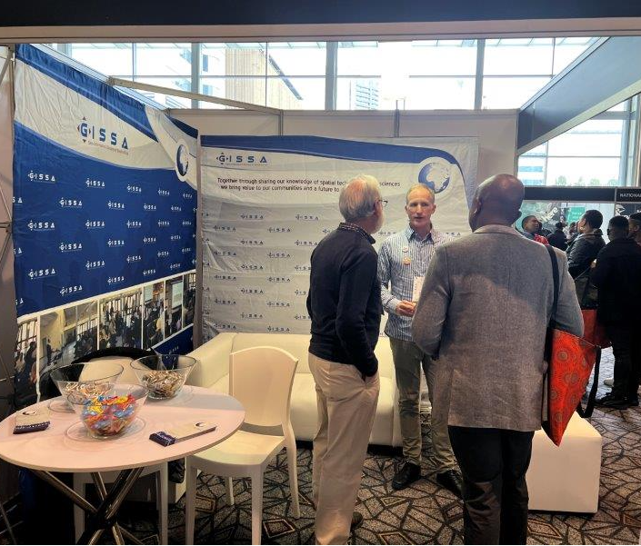

The Conference was aimed at providing a platform for delegates to acquire information on scientific developments, share knowledge, and network with professionals in the broad field of cartography.
Notes:
ICC conference where GISSA was a sponsor and attendee.
The event was an ideal melting pot of organizations to share their insights in the field but also to broaden their own knowledge.
The event drew presenters from across the country and from abroad.

Slide 7
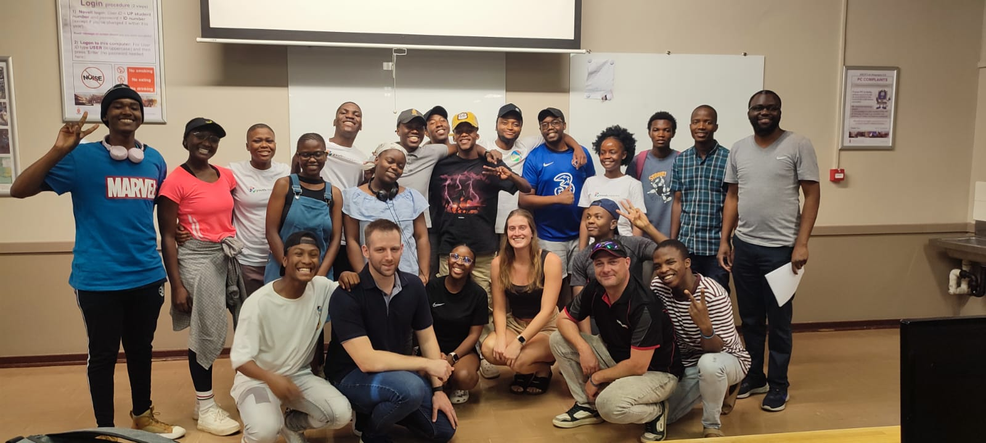
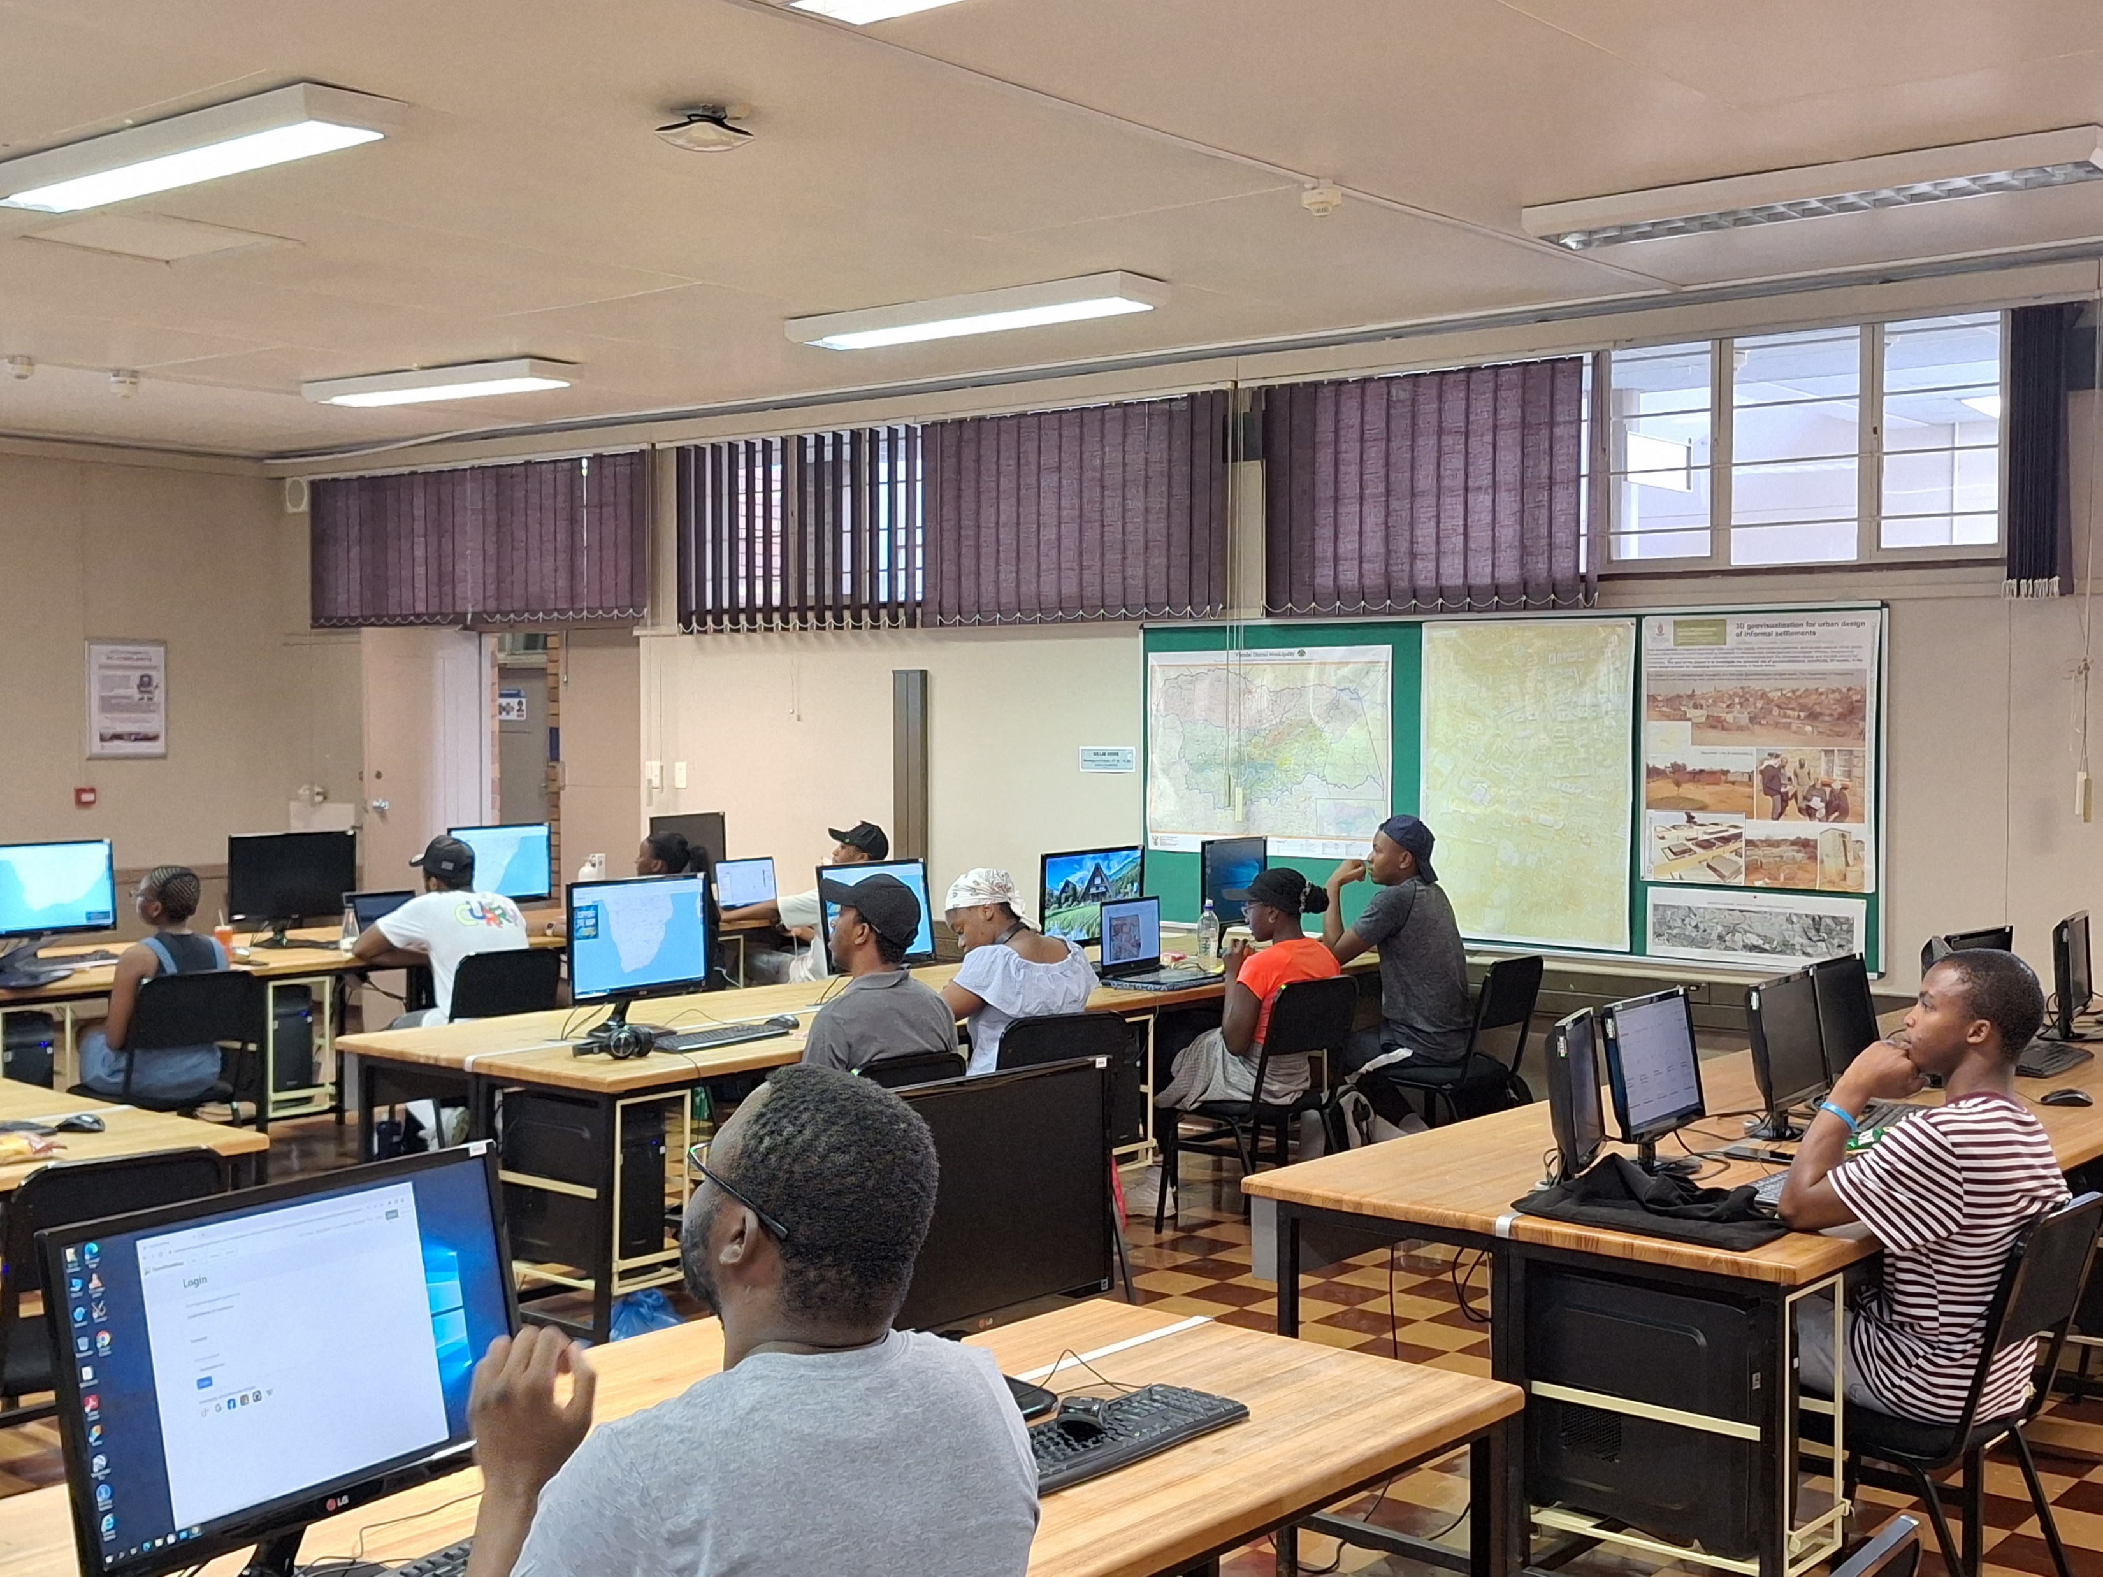
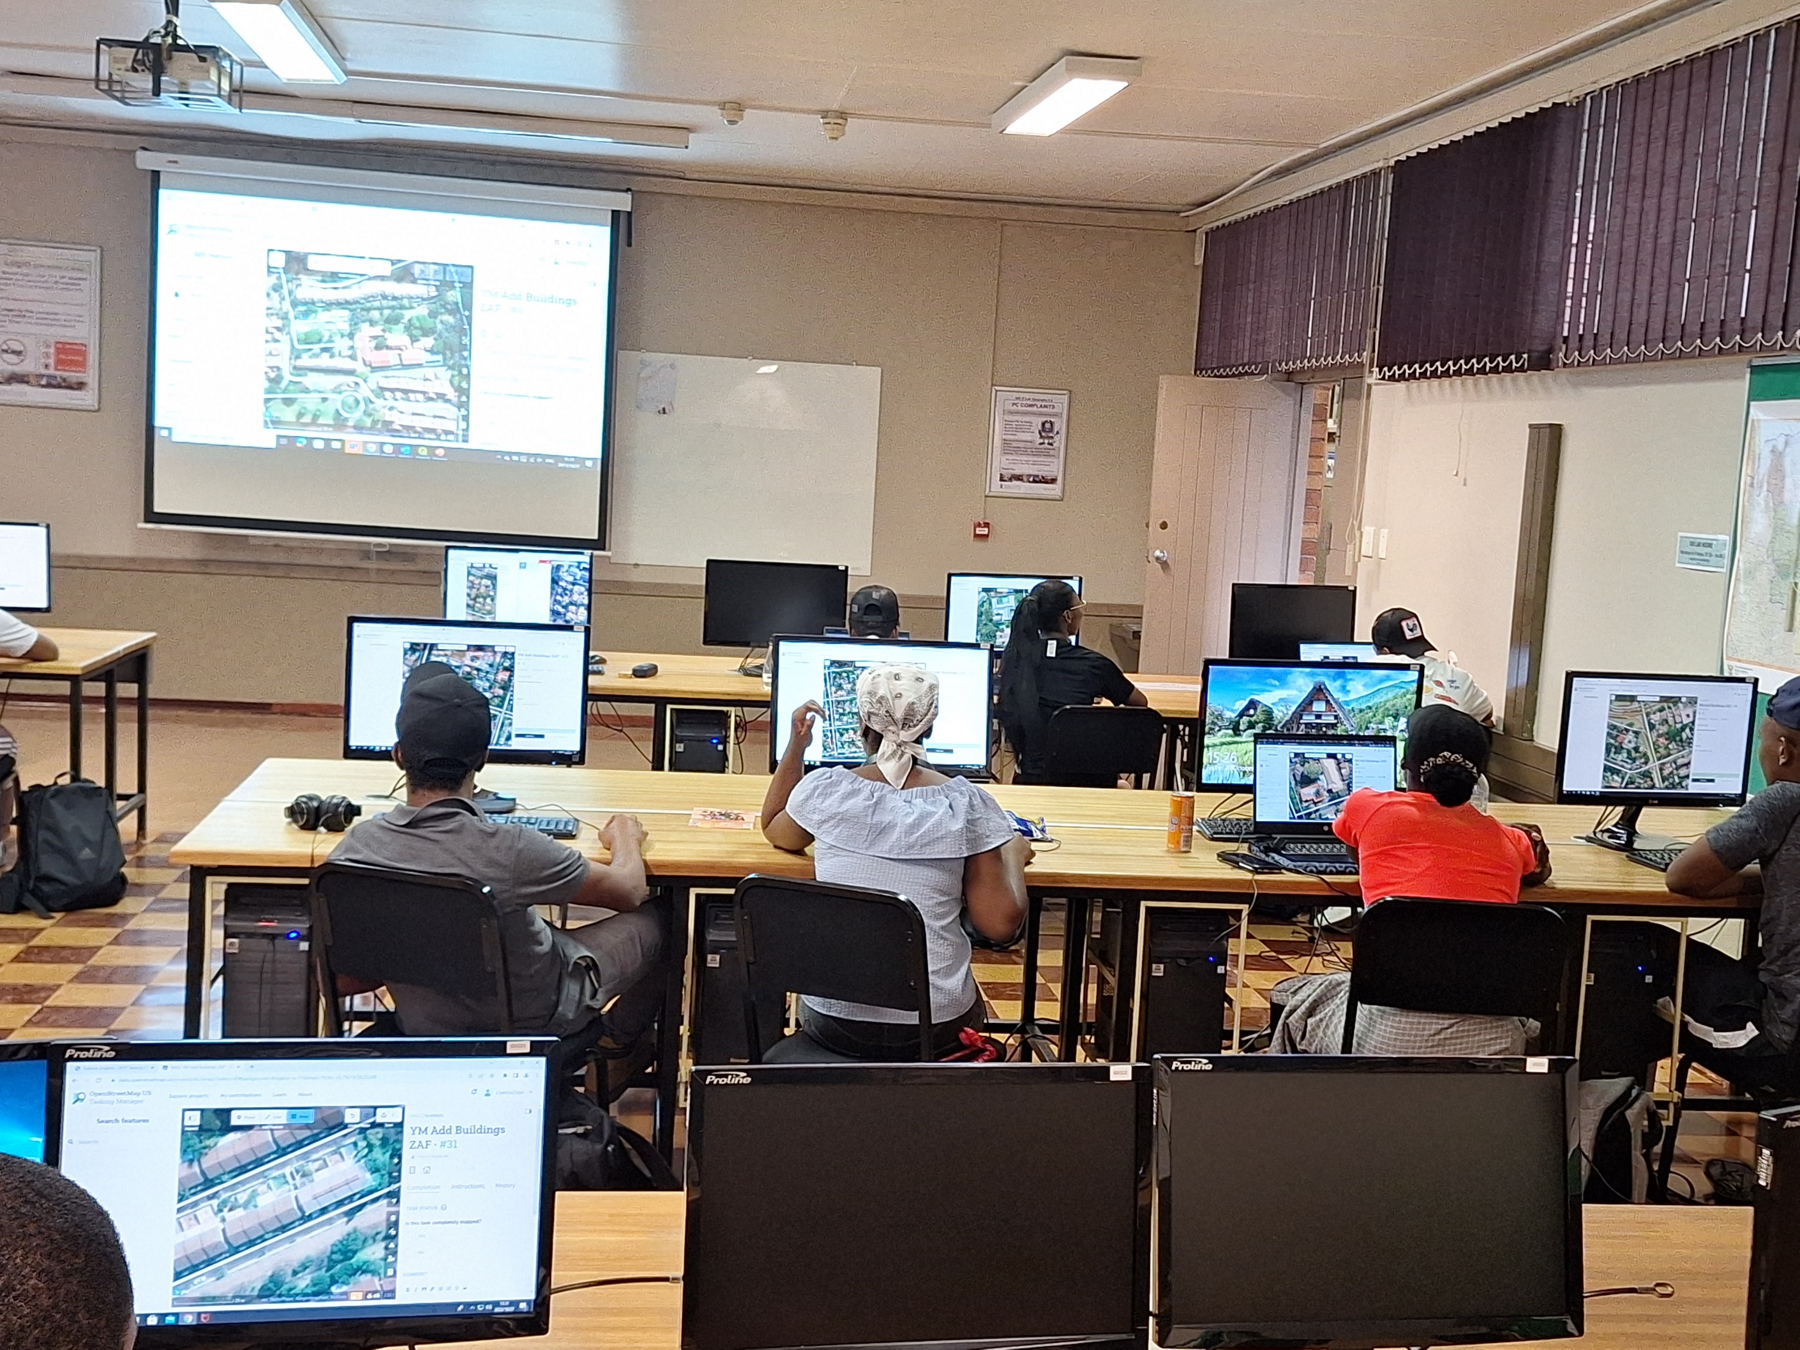

On October 27, 2023, our YouthMappers Mapathon event took place at the University of Pretoria. The objective was to familiarize participants with the mapping process, with a specific emphasis on creating Tasking Manager projects on the OpenStreetMap online platform. More information on the UP website here.
Notes:
As part of the skills development and training we also engage with youth organisation such as youthmappers.
Recently GISSA, The University of Pretoria and TomTom held a collaborative workshop for students. Providing them exposure to mapping platforms and techniques as well as practical experience.
The edits performed by these students are now Visible on Openstreetmap. Their efforts enriched a public platform that can assist multiple other industries in the future.

Slide 8
Institutions and higher learning
GISSA Focus areas
Advisory Role
  Engagements with the Council on Higher Education to influence the accreditation of the Geo Information Science programmes, and teachings in alignment with the global trends;
  Some GISSA members are already providing advisory services and assisting with the accreditations of some universities and institutions of higher learning, e.g. UP, WITS, UFS, Stellenbosch, UCT, Cape Peninsula, ESRI-SA.
Provide support to non-accredited universities for them to meet requirements
  Fort Hare, UKZN – advanced stage of accreditation
  NW, UJ, UNISA – in progress and has resources to be accredited
  Limpopo, Mpumalanga, Sol Plaatjie – visited and challenges still high
Need of external moderators
  Universities are looking for distinguished moderators on the GI Science for all levels, thanks to those already rendering the service.
Notes:
As you have seen in previous example, we collaborate with multiple institutions and organisations to facilitate specific goals.
In the past we have provided advisory services to the Council on Higher learning.
Along with the SAGC, we provide assistance for non-accredited universities in their efforts to meet credit requirements.
We also provide assistance in finding external moderators for GI Sciences across various subject.

Slide 9
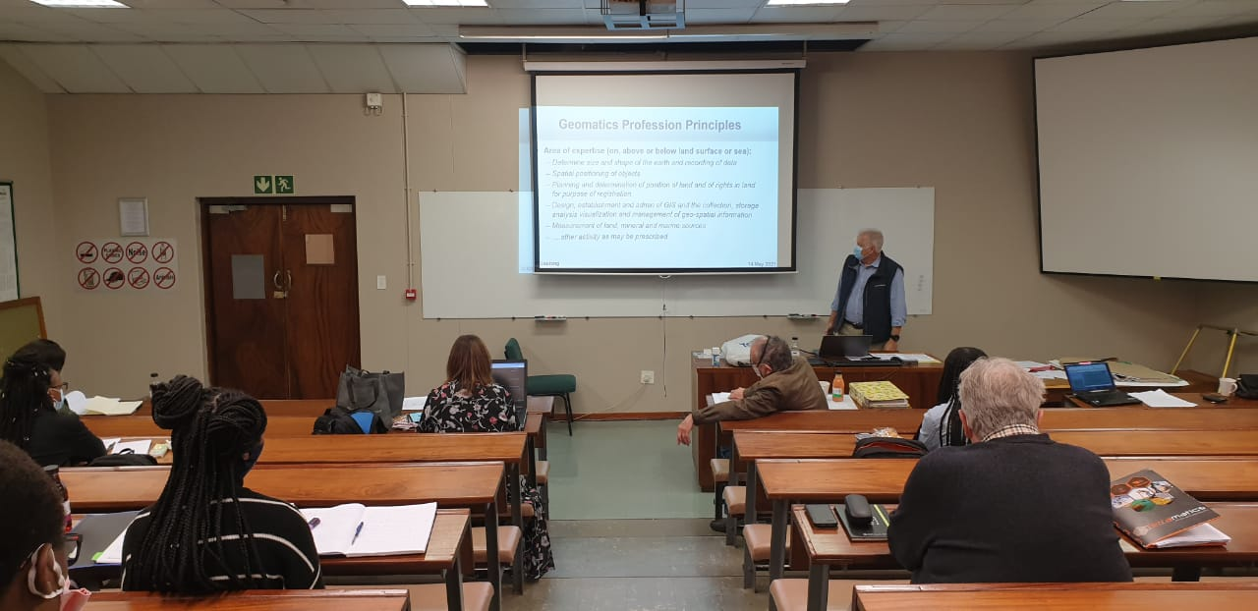
Institutions and higher learning
GISSA Focus areas
Our most recent SAGC exam preparation workshop. Held for aspiring Professionals to assist them while preparing for the Legislative and Ethics exam required for registration as a professional
Notes:
When professionals are ready to take their next step and register with the SAGC, GISSA provides support workshops to help prepare for these rigorous legal and ethics exams.

Slide 10



Research and Development
GISSA Focus areas
  Continuous support by the universities providing the skills audit survey of the profession as and when required;
  Opportunity to collaborate with research institutions for the advancement of geo information science;
    Establish relationships with the Human Sciences Research Council (HSRC);
    Establish relationships with the National Research Foundation (NRF);
    Council for Scientific and Industrial Research (CSIR); and
    Any other institute with matters connected therewith.
  Continue collaboration with the South African Bureau of Standards (SABS);
  Continue the support of the South African Journal of Geomatics editorial and compilation.
Notes:
GISSA also engages with multiple research and development institutes.
We facilitate open communication between multiple organisations and connect the private sector with these bodies as and when needed.
These efforts are aimed at opening up the data and knowledge to prevent siloing. By breaking down barriers on knowledge and data, we can accelerate advancements in the field.

Slide 11
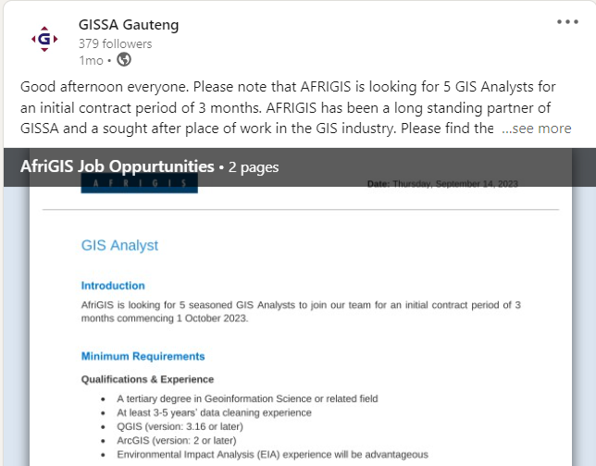
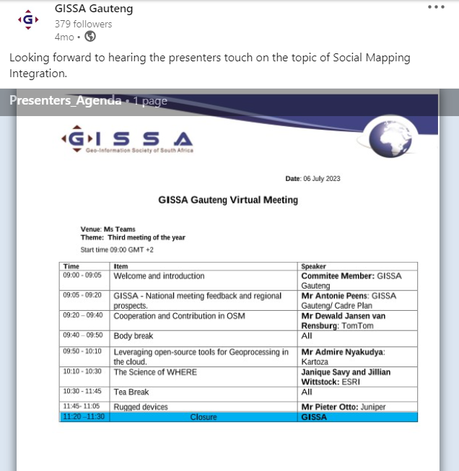
Industry engagement and opportunities
GISSA Focus areas
At the Provincial level, GISSA committees host regular events where we invite the industry, students, and academics to participate and share their knowledge.
Benefits to members:
  Knowledge sharing between organizations.
  Networking opportunities to expand your contacts and promote collaboration.
  Learners gain the opportunity to meet potential future employers.
  Students and Academics can share their research outside of the university.
  GISSA advertises vacancies and bursaries received from various players in the Geo-information space.
  Access to news and information on events.
Membership: Register on our website: https://gissa.org.za/
Membership fees: R550 for normal members; R100 for students and pensioners.
Follow us on LinkedIn
Notes:
Lastly we provide private sector engagement and share opportunities with members. Members can present research or news at our regular provincial meetings, advertise products, and share bursary and job opportunities.
This benefits all attendees by improving their knowledge in the field, expanding their networks, and providing an additional advertising platform.
GISSA Gauteng also posts regular updates, news and opportunities open for all those interested, and we would encourage you all to join.

Slide 12
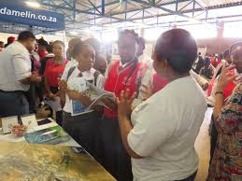
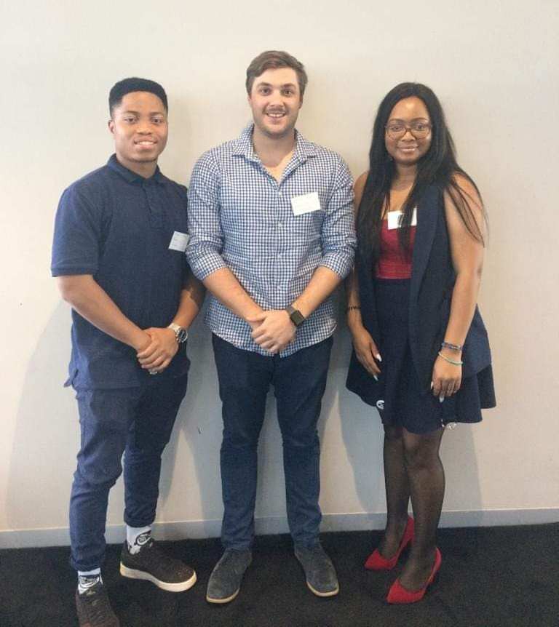
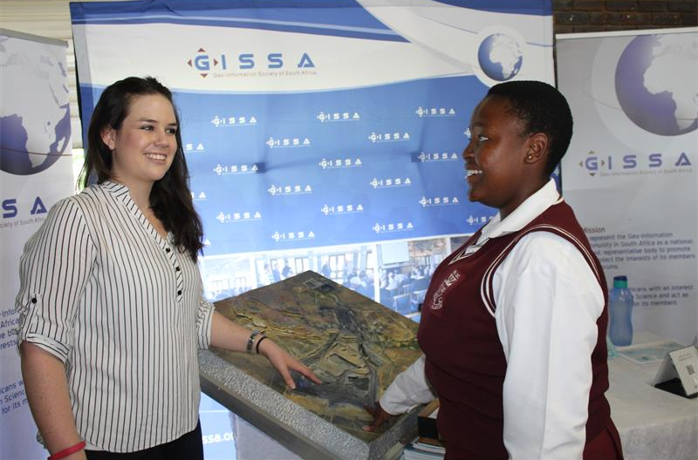
EDUCATION OUTREACH

Slide 13
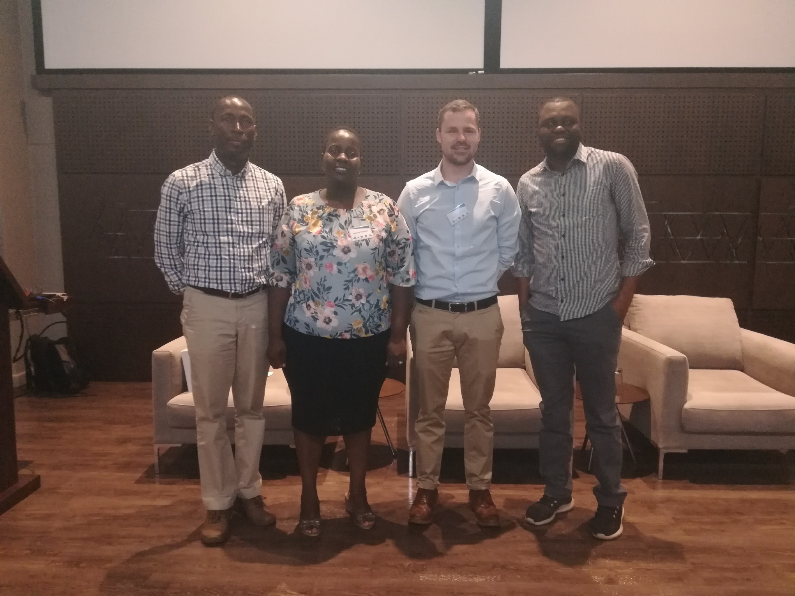
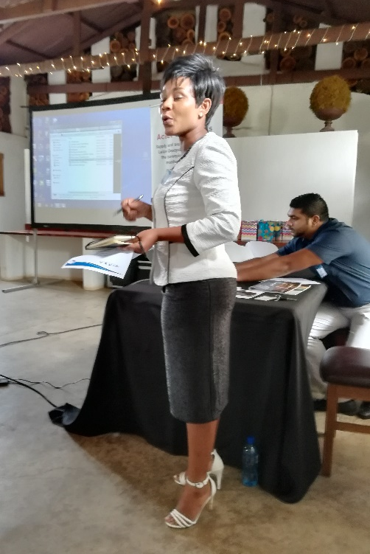
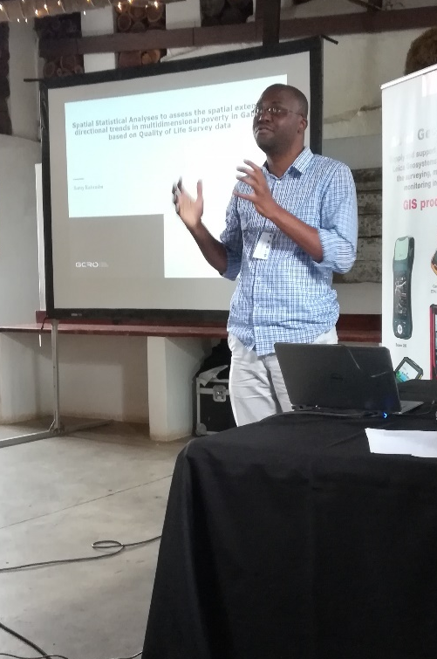
PAST SPEAKERS AND EVENTS

Slide 14
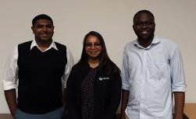
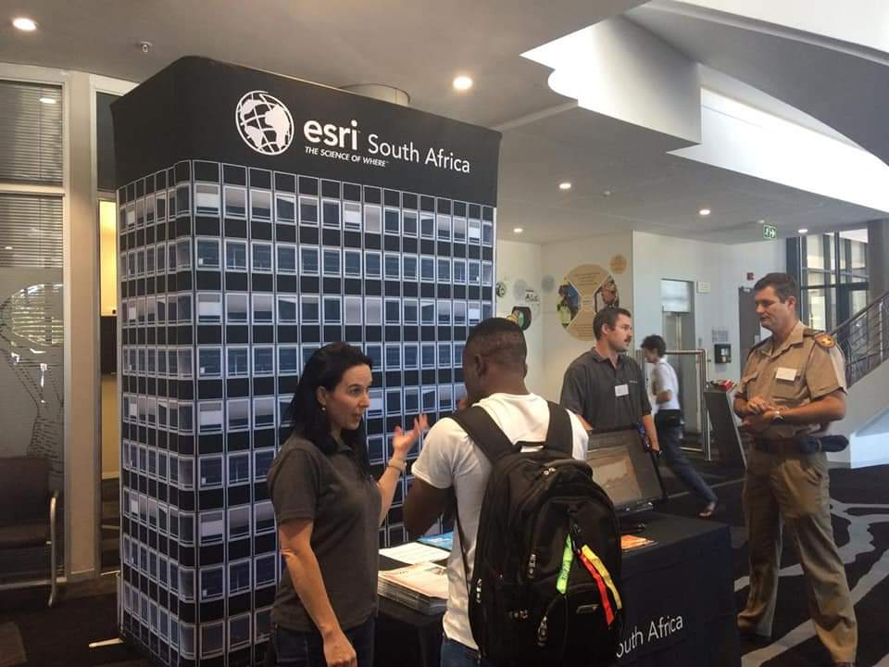
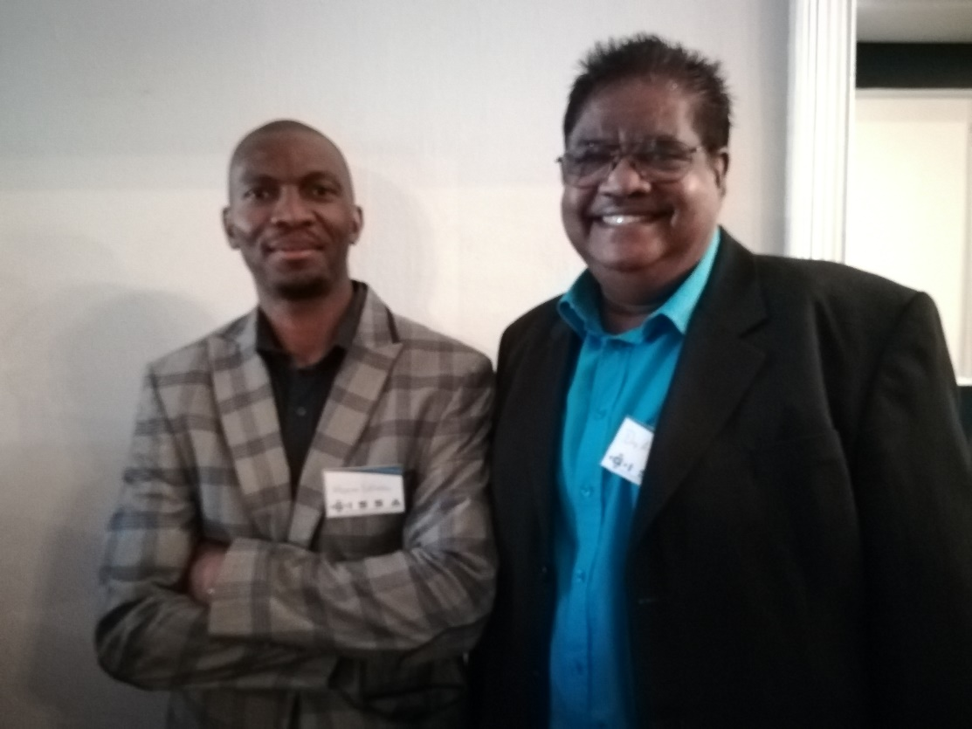
PAST SPEAKERS AND EVENTS

Slide 15
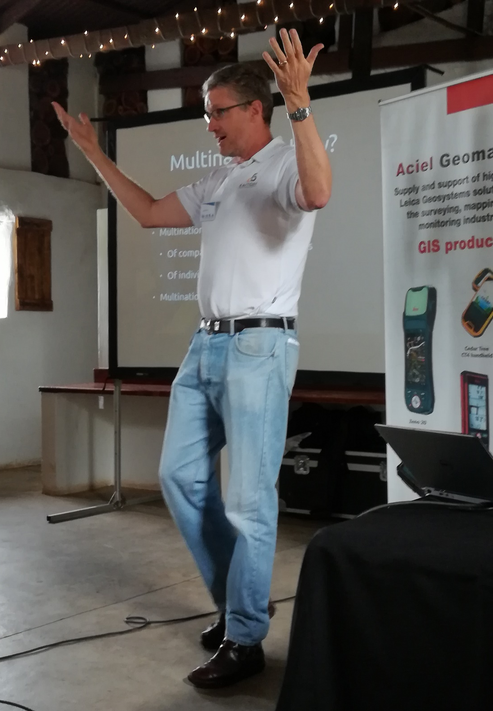
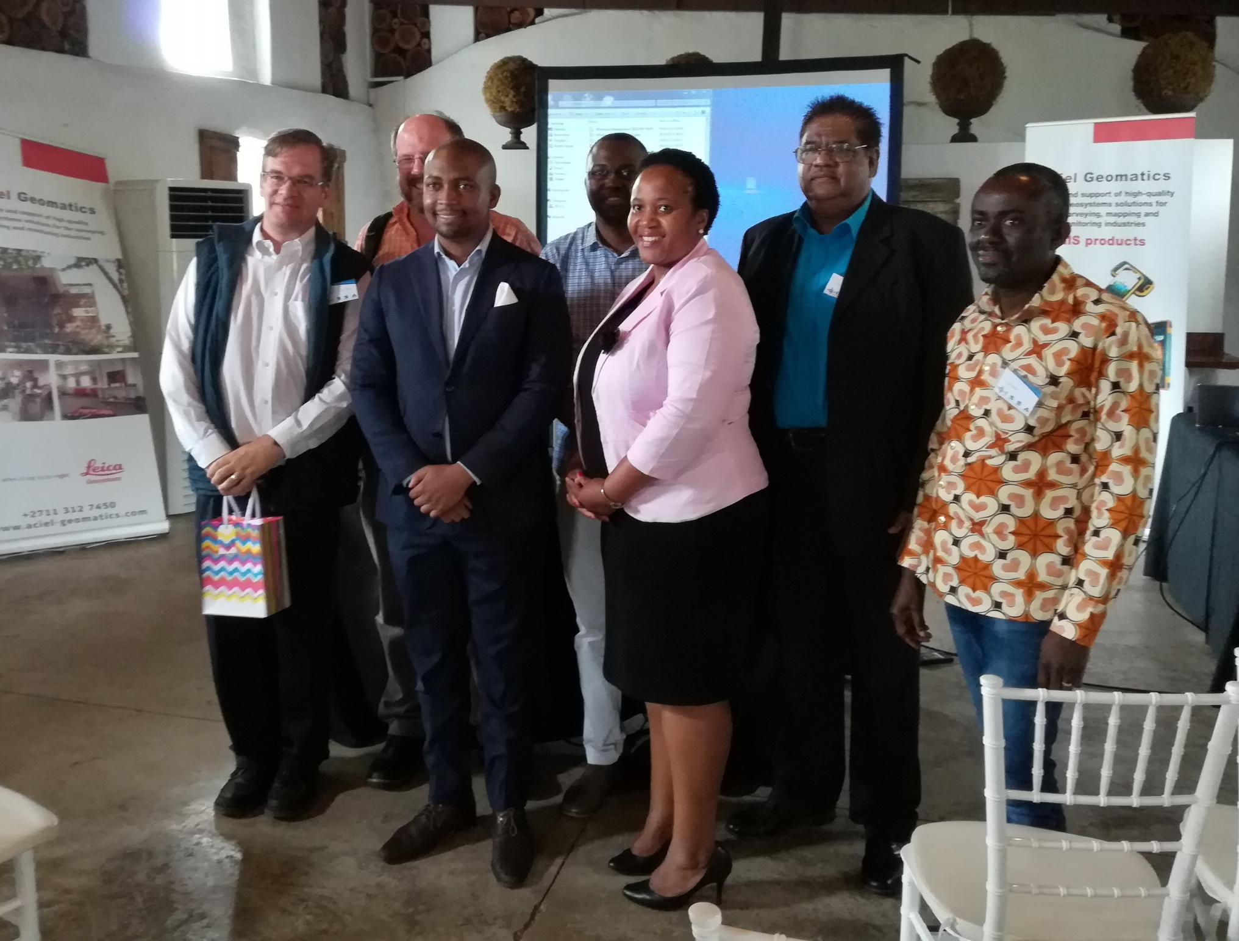
PAST SPEAKERS AND EVENTS

Slide 16
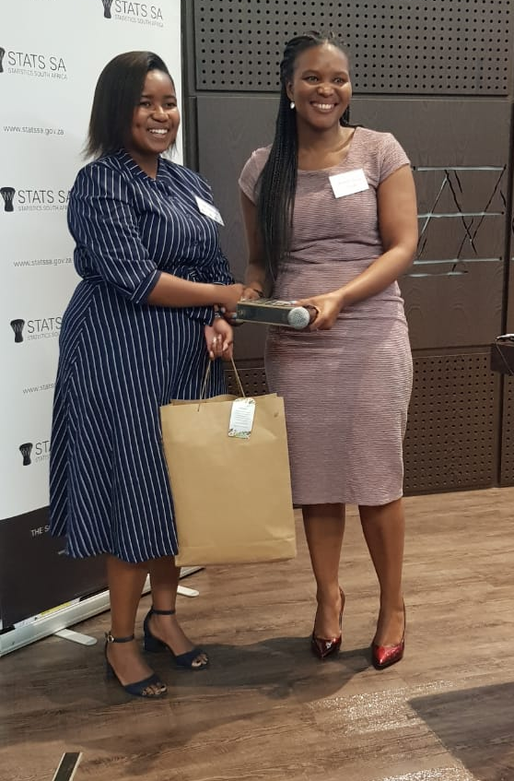
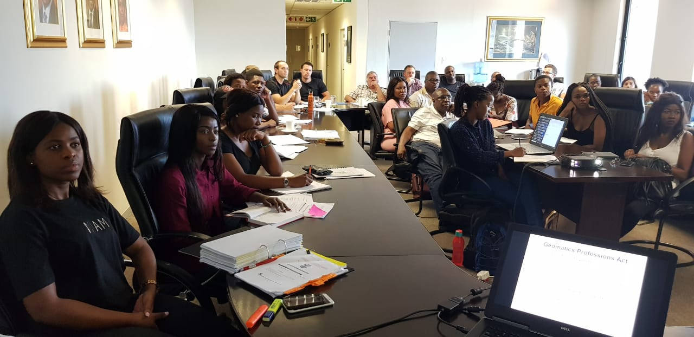
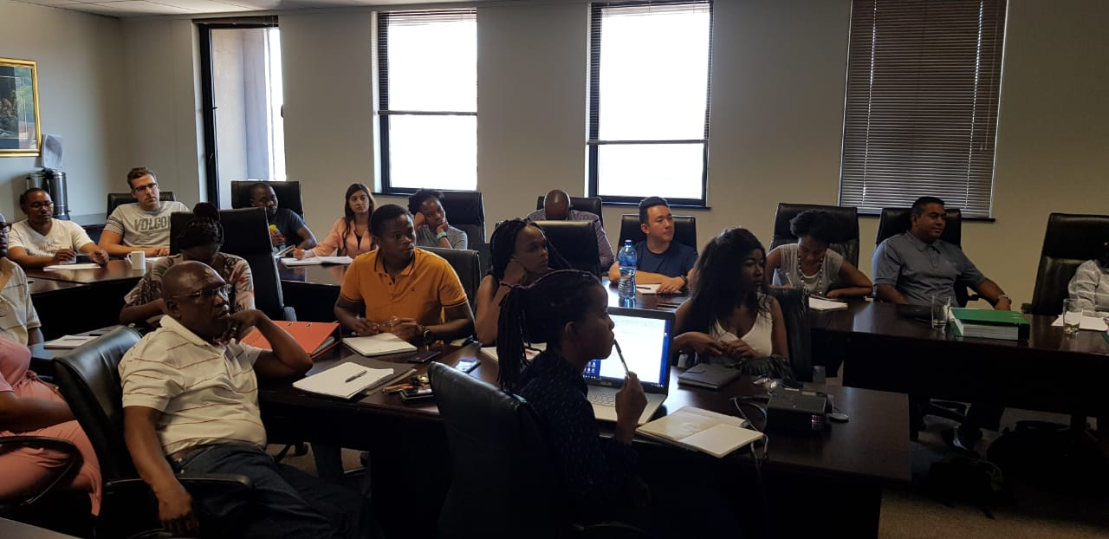
PAST SPEAKERS AND EVENTS

